Slide 1

Title: “Traffic Light Simulation with Timing Intervals and Visualization”

Slide 2
Presented By: Israt Jahan Eva(7B1_57) Irin Sultana Poly(7B2_91) Sadia Akter(7B1_59_) Asadur Rahman Asif(7B2_79)
Welcome to our presentation

Slide 3
Introduction
Key insight:
Timing Logic: Green, yellow, and red intervals control the traffic light cycle.
Visualization: Lights dynamically change color based on the simulation time
.
Synchronization: Only one direction gets a green light at a time, ensuring safe traffic flow.
Modular Design: Easily adjustable timing parameters allow customization for different scenarios.
Tools: MATLAB for data analysis and simulation.

Slide 4
Objectives
1. Manage Traffic Flow
2. Control Light Timings
3. Ensure Safety
4. Visualize Light Changes
5. Adapt to Different Scenarios
6. Simulate Realistic Patterns

Slide 5
Key Features: Simulates realistic traffic light transitions. Highlights active lanes dynamically.
Why This Project Matters: Enhances understanding of traffic management systems. Demonstrates coordination of complex logic.

Slide 6
Problem Statement
Scenario:
Four-way intersection with two lanes per road (Left & Right).
Smooth traffic flow depends on synchronized light cycles.
Challenges:
Coordinating 8 traffic lights across multiple directions.
Highlighting the active lanes for visualization clarity.

Slide 7
Implementation
Intersection Layout: Designed a 4-way junction with clear lanes
Traffic Light Logic: Green (15s), Yellow (5s), Red cycles calculated dynamically.
Simulation Phases: Four phases with corresponding active lanes.
Highlighting Active Lanes: Outlines active lights for better visualization.

Slide 8
Simulation Phases Visual Representation
**Phase 1: EL (East Left) is Green; SR, WR, NR are Green.
** Phase 2: SL (South Left) is Green; WR, NR, ER are Green.
**Phase 3: WL (West Left) is Green; NR, ER, SR are Green.
** Phase 4: NL (North Left) is Green; ER, SR, WR are Green.
Key Features: Clear intersection with visible divider lines. Active light highlighted with an outline.
Real-time updates of light transitions. (Include a screenshot of the simulation output.)

Slide 9
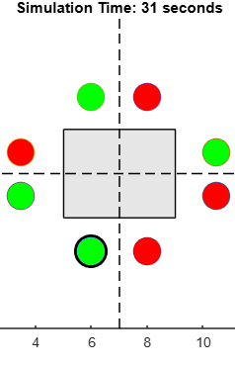
Results and Benefits
output
Results: Successfully simulated multi-lane traffic light transitions. Highlighted active lights for better understanding.
Benefits: Aids in traffic flow optimization research. Provides a foundation for advanced traffic management systems

Slide 10
conclusion
This project demonstrates effective simulation of a multi-lane intersection. The dynamic highlighting feature enhances visual clarity.
Future Scope: Introduce vehicle flow density adjustments. Integrate with AI-based traffic optimization systems.

Slide 11
Acknowledgment
Thank you
for your
time and attention!

